Slide 1
Version Control Tools that will assist in the development of smart solutions
JAUMEER Shabneez 1415376
HULKURY Wazeefah 1413283
AWOOTAR Priyanka 1414006
SALANDY Oushna 1415294

Slide 2
Agenda
Smart solutions
Breaking smart solutions into teams
Version Control Tools
Strengths & Weaknesses of Version Control Tools
Choice of Version Control Tools
Comparative Table
Criteria to consider prior to choosing tool

Slide 3
Bahir Dar (Ethiopia)
Maputo (Mozambique)
Overpopulation
Health
Fire Outbreak
Tuberculosis
Tourism
Sanitation
Flooding
Traffic Congestion
Road development
Water Management
Transport
Poor Lighting
Shopping
Overpopulation
Tourism
Monorovia (Liberia)

Slide 4
Smart Solutions
Fire Outbreaks
Fire detector system to sense fire
Sensors measure the increasing temperature and trigger a signal
Alert the surroundings of the incoming danger
Flooding
Flood detector system to detect rainfall conditions and severe flooding
Sensors measure the increased water level and alert the authorities via SMS

Slide 5
Smart Solutions
Inaccurate Tuberculosis Check
Accuracy Detector System to detect quality of machines that detect TB diagnosis
Assess whether these machines are functionally properly and accurately.
Poor Street lighting
Street Light Control and Management System that uses wireless technology
Automatic on and off control based on local sunrise and sunset schedules
Monitoring of street light performance 24/7
Provide improved visibility in the night and Reduce, energy consumption, the manpower and resources

Slide 6
Smart Solutions
Sanitation
Provide bins with sensors and Gps tracker
Collect trash for recycling for waste management
Water Management
Develop a mobile application to repair drainage system in various areas
Upload pictures and videos to track affected areas
Road development
Building paved lanes and make use of motion sensor lightning
Safety Assurance and surveillance
24/7 access control and oversight

Slide 7
Smart Solutions
Traffic Congestion
Develop a smart parking system
Locate specific parking to car owners , therefore forbidding people to park in places which may be allowed legally but block the traffic
Less development of tourism sector
Develop a mobile application with GPS tracker
Provide different places of interest
Can help tourists throughout the island
Increase in revenue

Slide 8
Smart Solutions
Overpopulation
Developing an application that helps in the birth control mechanism telling people when they are more apt to get pregnant depending on their ovulation date.
Shopping
Multiple short range detectors deployed at selected locations to facilitate indoor navigation
Best available deal shown via the shopping experience of other customers
Online shopping

Slide 9
Smart Solutions
Transport
GPS tracker to keep track of bus location
Digital bus stops to display information on bus time table
Sensors to check engine level, oil level and tyre pressure
Detect and warn drivers of speed limit
Health
Doctors - Patients Follow Up
Hardware equipped to determine blood pressure
Symptom Checker & Chat Area
Emergency ambulance

Slide 10




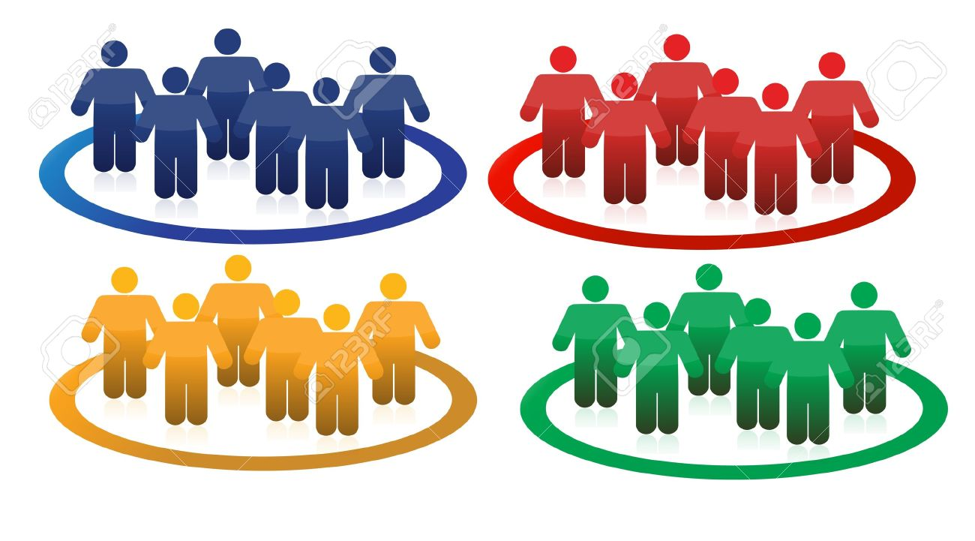
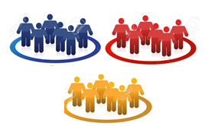
Framework – Breaking solutions between teams
4 solutions/team of 10 people
4 solutions/team of 10 people
4 solutions/team of 10 people
3 solutions/team of 10 people

Slide 11
Version Control Tools
Used by software development teams to streamline the development process, manage code for multiple projects, and maintain a history of code changes.
There are 3 types of version control systems in which we can have both open-source and proprietary systems
Local
Client-Server
Distributed

Slide 12
Version Control Tools
Plastic SCM
Mercurial
Git
Team Foundation Server
Monotone
Visual Studio Team Services
Rational Synergy
Veracity

Slide 13


Plastic SCM
Mercurial
Pros | Cons
Much better branching and merging | Cannot remove branches
Developers can sync with Git
Diff code semantically
Proprietary distributed version control tool designed for large projects
Pros | Cons
Fast and scalable | No merging of more than 2 parents
Platform independent | Extension based rather than scriptability
Easy to use
Open source distributed version control tool designed for large projects

Slide 14
Git Git is a distributed version control system written by the creator of linux, Linus Torvalds.
Pros | Cons
Makes for easier contributions to your top open source projects | May not communicate very well in layman’s terms
Has everything turned into Markdown.
Has some of the best documentation around
Has Gists and GitHub Pages

Slide 15
Team Foundation Server It is a Microsoft product that provides source code management, reporting, requirements management, project management, automated builds, lab management, testing and release management capabilities
Pros | Cons
Helps to Manage team workflow | Security Can you trust the hosting provider with your data?
Helps to take real-time decisions | Performance TFS is slow at the best of times - having it remote is a risk to performance
Drive predictability | Integration Can you use your corporate directory accounts to access or do you need "another user id and password" to remember?
Deliver Early, Deliver Often, Drive quality
Support the use of familiar tools

Slide 16
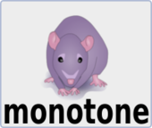
Monotone
Open source software tool for distributed revision
Pros | Cons
Good support for internationalization and localization | Potential users cannot check out from behind a proxy
Can import CVS projects. | Less Popular
Signing of revisions using RSA certificates | Performance issues
Easy to learn
Very good at branching and merging
Good Documentation
Very low maintenance
Portable design, implemented in C++

Slide 17

Visual Studio Team ServicesPerformance Issu
Proprietary client server version tool used by small and growing teams
Pros | Cons
Makes s/w lifecycle better and faster | Not open source for growing teams
Release Management
Package Management
Simplifies Continuous Integration
Provide Agile Tools
Git for individuals, teams and enterprises
Enables DevOps for applications written in any languages
Accelerate high quality s/w delivery

Slide 18
Rational Synergy
A task-based, SCM solution bringing together global, distributed development teams on a central configuration and release management platform
Pros | Cons
Helps software delivery teams work and collaborate faster and easier | Deleted file does not get deleted from all work areas
Accelerates software development, maintains quality and avoids effort duplication | Not Free of Cost
Helps support software reuse and component-based development
User friendly, easy-to-use GUIs, and Simple task-based approach to tracking changes
Delivers a high scalable platform, that integrates with IBM Rational software products

Slide 19

Veracity
An Open Source, distributed version control and bug tracking system for Linux, Mac OS, Windows
Pros | Cons
Keep track of reported software bugs | No integrated digital signed revisions
Makes the software more attractive in a corporate environment | Makes uses of C programming language only
Merge or Lock Concurrency Model
Free of cost
Make use of Agile Development Tools

Slide 20
Choice of Version Control Tools
After evaluating the different pros and cons of the tools, we have shortlisted the tools to ultimately get a comparative table of their features and to decide on one final tool.
The decision making process which lead to our shortlisted tools is based on an elimination process.

Slide 21
Choice of Version Control Tools - Continued
The first two tools to be eliminated are Team Foundation Server and Monotone due to their slow performance which in one of the crucial aspect of our project. Moreover, Git is being excluded as it does not facilitate bug tracking and file lock concurrency. And also it is difficult for a layman to understand some complex commands.
Our shortlisted list of tools are
Plastic SCM
Visual Studio Team Services
Mercurial
Rational Synergy
Veracity
Their features will be listed in the comparative table in the future slide.

Slide 22
Comparative Table
Features | Veracity | Plastic SCM | Mercurial | Rational Synergy | Visual Studio Team Services
Bug Tracking | Yes | No | No | Yes | Yes
Use of Agile Tools | Yes |  | No |  | Yes
Programing Language | C | Any | C, Python | Java | Any
File Lock | Yes | Yes | No | Yes | Yes
Scalable |  | Yes | Yes | Yes | Yes
Open Source | Yes | No | Yes | No | No
Support Large Repositories efficiently | Yes | Yes | Partially | Yes | Yes

Slide 23
Criteria to consider prior to choosing tools
Centralized vs. distributed model
Size of team
Open source vs proprietary
Project management features
Bug tracking

Slide 24
Final choice of tool
Tool Selected: Visual Studio Team Services
It is both centralised and distributed
It is appropriate for a team size of 150 developers
Good project management features
Effective in bug tracking
Even though it is not open source, it is worth to pay for a tool which provides these features above

Slide 25
Thank you for your attention!

